Slide 1

Mediation and Moderation Analysis in ERGM using ergMargins
Scott Duxbury
Assistant Professor
University of North Carolina, Chapel Hill
Department of Sociology
duxbury@email.unc.edu

Slide 2
Workshop overview
Discuss why special procedures are necessary to conduct mediation and moderation analysis in ERGM
Overview procedures for testing indirect effects and interaction effects
a. Single mediator models, multiple mediator models, moderated mediation, and mediated moderation
Introduce ergMargins

Slide 3
Key citations for this workshop
Duxbury, Scott W. 2021. “The Problem of Scaling in Exponential Random Graph Models.” Sociological Methods & Research. DOI: https://doi.org/10.1177/0049124120986178
Duxbury, Scott W. 2019. “ergMargins: Process Analysis for ERGM.” CRAN.

Slide 4
Workshop overview
Discuss why special procedures are necessary to conduct mediation and moderation analysis in ERGM
Overview procedures for testing indirect effects and interaction effects
a. Single mediator models, multiple mediator models, moderated mediation, and mediated moderation
Introduce ergMargins

Slide 5
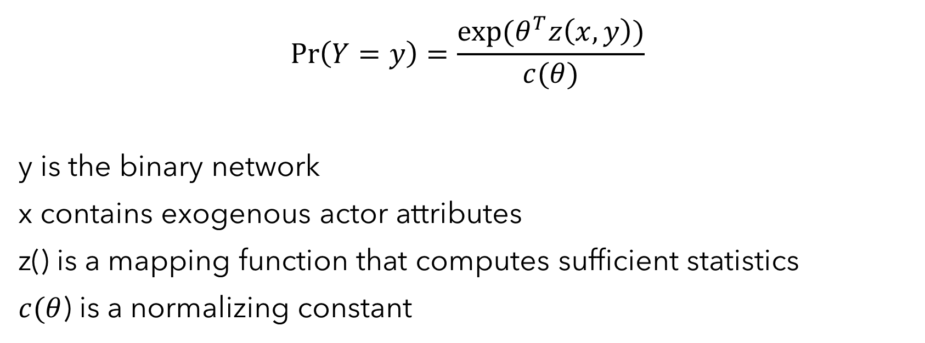
Why we need special procedures
$$\operatorname{Pr}\left(Y=y\right)=\frac{exp⁡(θ^{T}z\left(x,y\right))}{c(θ)}$$
y is the binary network
x contains exogenous actor attributes
z() is a mapping function that computes sufficient statistics
$c(θ$) is a normalizing constant

Slide 6
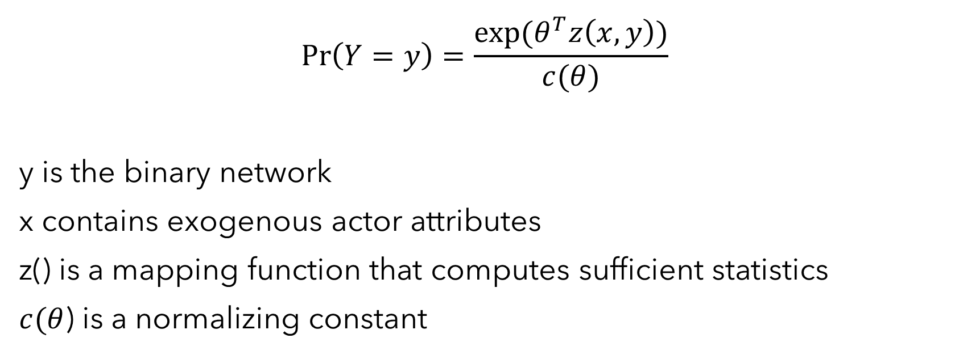
Why we need special procedures
We can re-express the model to relate only to tie probabilities
$$\operatorname{Pr}\left(Y=y\right)=\frac{exp⁡(θ^{T}z\left(x,y\right))}{c(θ)}$$
y is the binary network
x contains exogenous actor attributes
z() is a mapping function that computes sufficient statistics
$c(θ$) is a normalizing constant

Slide 7
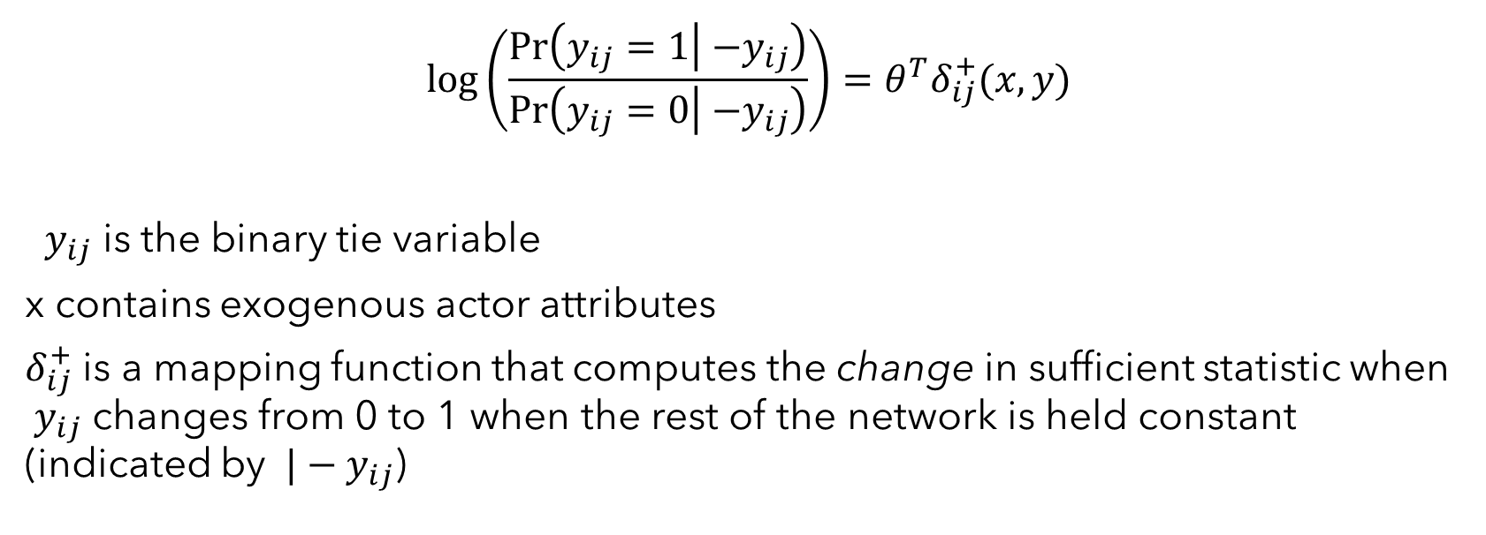
Why we need special procedures
We can re-express the model to relate only to tie probabilities
$$\log\left(\frac{\operatorname{Pr}\left(y_{ij}=1 | { −y}_{ij}\right)}{\operatorname{Pr}\left(y_{ij}=0 | { −y}_{ij}\right)}\right)=θ^{T}δ_{ij}^{+}(x,y)$$
${ y}_{ij}$ is the binary tie variable
x contains exogenous actor attributes
$δ_{ij}^{+}$ is a mapping function that computes the change in sufficient statistic when ${ y}_{ij}$ changes from 0 to 1 when the rest of the network is held constant (indicated by ${ |−y}_{ij}$)

Slide 8
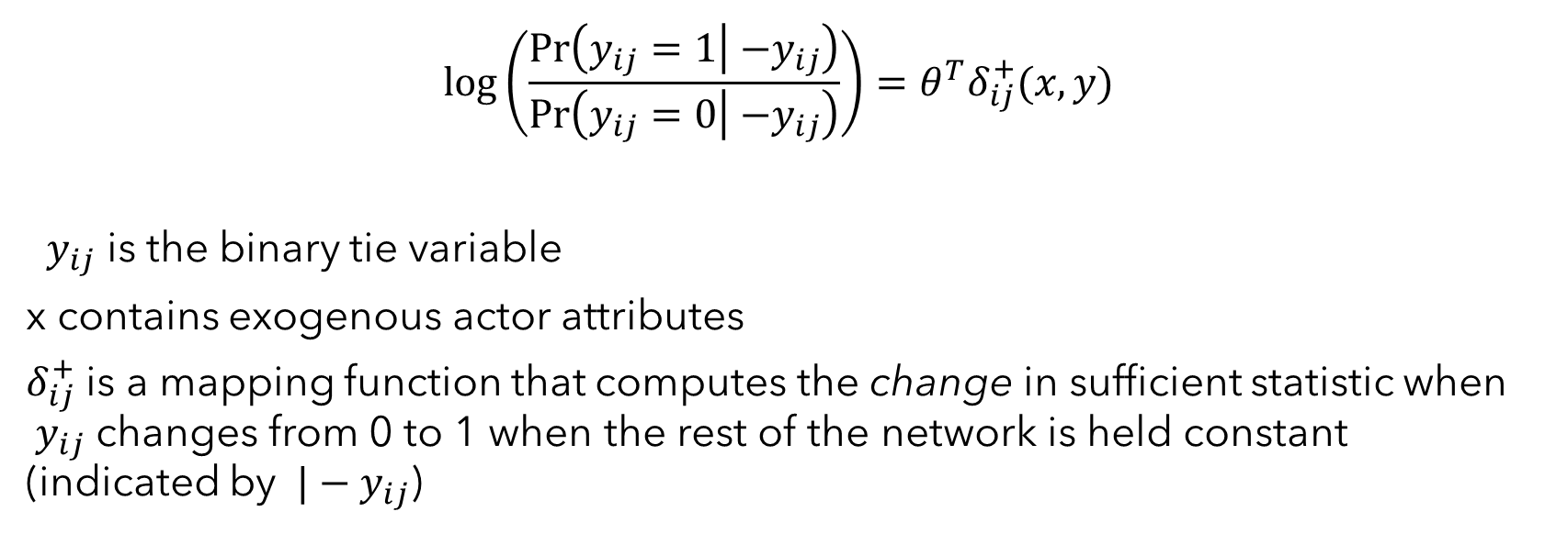
Why we need special procedures
The micro-model gives us a functional form that is equivalent to logistic regression
The only difference between the micro-model and logistic regression occurs in dyad dependent ERGM when endogenous sufficient statistics are included as predictors
$$\log\left(\frac{\operatorname{Pr}\left(y_{ij}=1 | { −y}_{ij}\right)}{\operatorname{Pr}\left(y_{ij}=0 | { −y}_{ij}\right)}\right)=θ^{T}δ_{ij}^{+}(x,y)$$
${ y}_{ij}$ is the binary tie variable
x contains exogenous actor attributes
$δ_{ij}^{+}$ is a mapping function that computes the change in sufficient statistic when ${ y}_{ij}$ changes from 0 to 1 when the rest of the network is held constant (indicated by ${ |−y}_{ij}$)

Slide 9
Why we need special procedures
The problems we discuss today inherit from this functional form. In fact, the problem of “scaling” in ERGM is identical to the problem of scaling in other nonlinear probability models.
$$\log\left(\frac{\operatorname{Pr}\left(y_{ij}=1 | { −y}_{ij}\right)}{\operatorname{Pr}\left(y_{ij}=0 | { −y}_{ij}\right)}\right)=θ^{T}δ_{ij}^{+}(x,y)$$
${ y}_{ij}$ is the binary tie variable
x contains exogenous actor attributes
$δ_{ij}^{+}$ is a mapping function that computes the change in sufficient statistic when ${ y}_{ij}$ changes from 0 to 1 when the rest of the network is held constant (indicated by ${ |−y}_{ij}$)

Slide 10
Why we need special procedures
To illustrate this, we’ll take a latent modeling approach, though we’ll also describe why this approach isn’t necessary to represent the problems we encounter.
$$\log\left(\frac{\operatorname{Pr}\left(y_{ij}=1 | { −y}_{ij}\right)}{\operatorname{Pr}\left(y_{ij}=0 | { −y}_{ij}\right)}\right)=θ^{T}δ_{ij}^{+}(x,y)$$
${ y}_{ij}$ is the binary tie variable
x contains exogenous actor attributes
$δ_{ij}^{+}$ is a mapping function that computes the change in sufficient statistic when ${ y}_{ij}$ changes from 0 to 1 when the rest of the network is held constant (indicated by ${ |−y}_{ij}$)

Slide 11
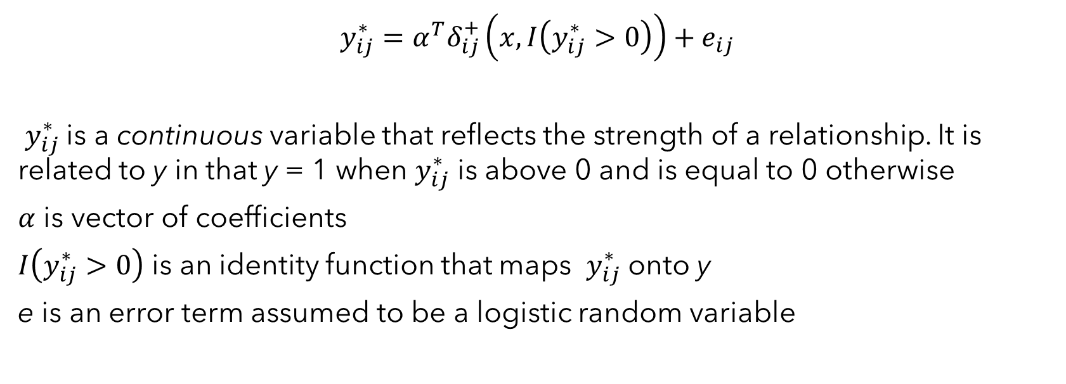
A latent linear modeling perspective on ERGM
To begin, we write a latent linear model for ERGM
$$y_{ij}^{∗}=α^{T}δ_{ij}^{+}\left(x,I\left(y_{ij}^{∗}>0\right)\right)+e_{ij}$$
$y_{ij}^{∗}$is a continuous variable that reflects the strength of a relationship. It is related to y in that y = 1 when $y_{ij}^{∗}$ is above 0 and is equal to 0 otherwise
$α$ is vector of coefficients
$I\left(y_{ij}^{∗}>0\right)$ is an identity function that maps $y_{ij}^{∗}$ onto y
e is an error term assumed to be a logistic random variable

Slide 12
A latent linear modeling perspective on ERGM
A unique aspect of this model is that now we get an error term.
Like other generalized linear models, we assume the error has mean 0. When violated, we get omitted variable bias
$$y_{ij}^{∗}=α^{T}δ_{ij}^{+}\left(x,I\left(y_{ij}^{∗}>0\right)\right)+e_{ij}$$
$y_{ij}^{∗}$is a continuous variable that reflects the strength of a relationship. It is related to y in that y = 1 when $y_{ij}^{∗}$ is above 0 and is equal to 0 otherwise
$α$ is vector of coefficients
$I\left(y_{ij}^{∗}>0\right)$ is an identity function that maps $y_{ij}^{∗}$ onto y
e is an error term assumed to be a logistic random variable

Slide 13

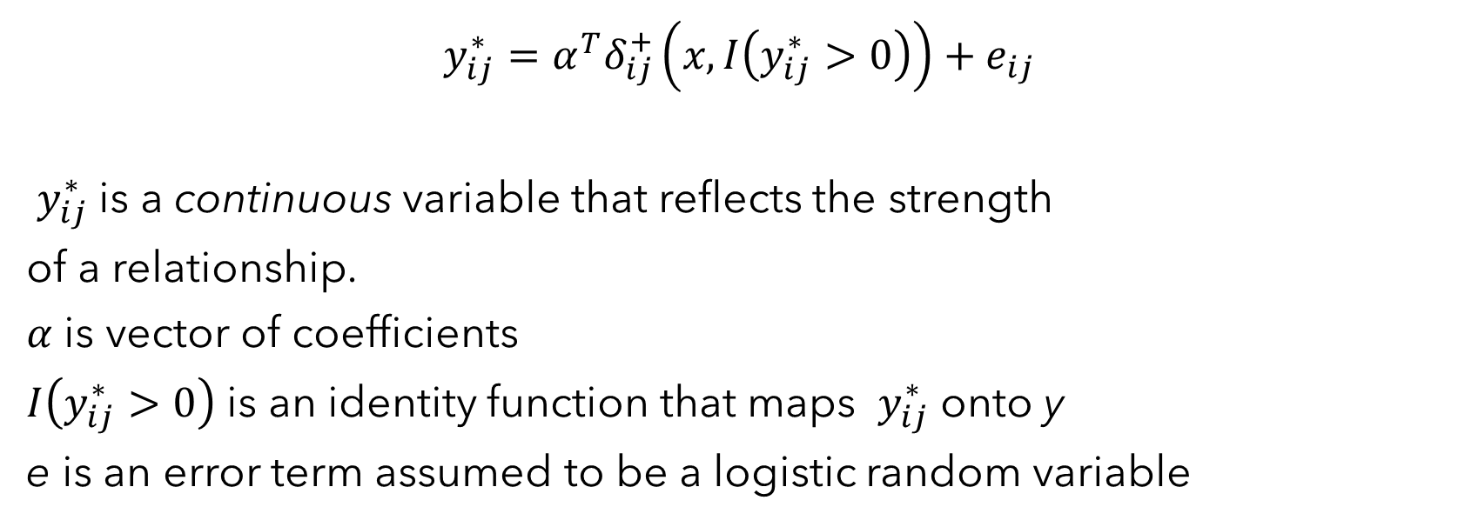
A latent linear modeling perspective on ERGM
Unlike other GLMs, however, now we also require an assumption on the variance because the error is unobserved.
Because we are assuming a logistic functional form, the error is assumed to be a logistic random variable with mean 0 and variance $\frac{π^{2}}{3}$
$$y_{ij}^{∗}=α^{T}δ_{ij}^{+}\left(x,I\left(y_{ij}^{∗}>0\right)\right)+e_{ij}$$
$y_{ij}^{∗}$is a continuous variable that reflects the strength
of a relationship.
$α$ is vector of coefficients
$I\left(y_{ij}^{∗}>0\right)$ is an identity function that maps $y_{ij}^{∗}$ onto y
e is an error term assumed to be a logistic random variable

Slide 14

A latent linear modeling perspective on ERGM
When this assumption is correct, the latent coefficients are equal to the observed coefficients, e.g.:
$α= θ$
$$y_{ij}^{∗}=α^{T}δ_{ij}^{+}\left(x,I\left(y_{ij}^{∗}>0\right)\right)+e_{ij}$$
$y_{ij}^{∗}$is a continuous variable that reflects the strength
of a relationship.
$α$ is vector of coefficients
$I\left(y_{ij}^{∗}>0\right)$ is an identity function that maps $y_{ij}^{∗}$ onto y
e is an error term assumed to be a logistic random variable

Slide 15

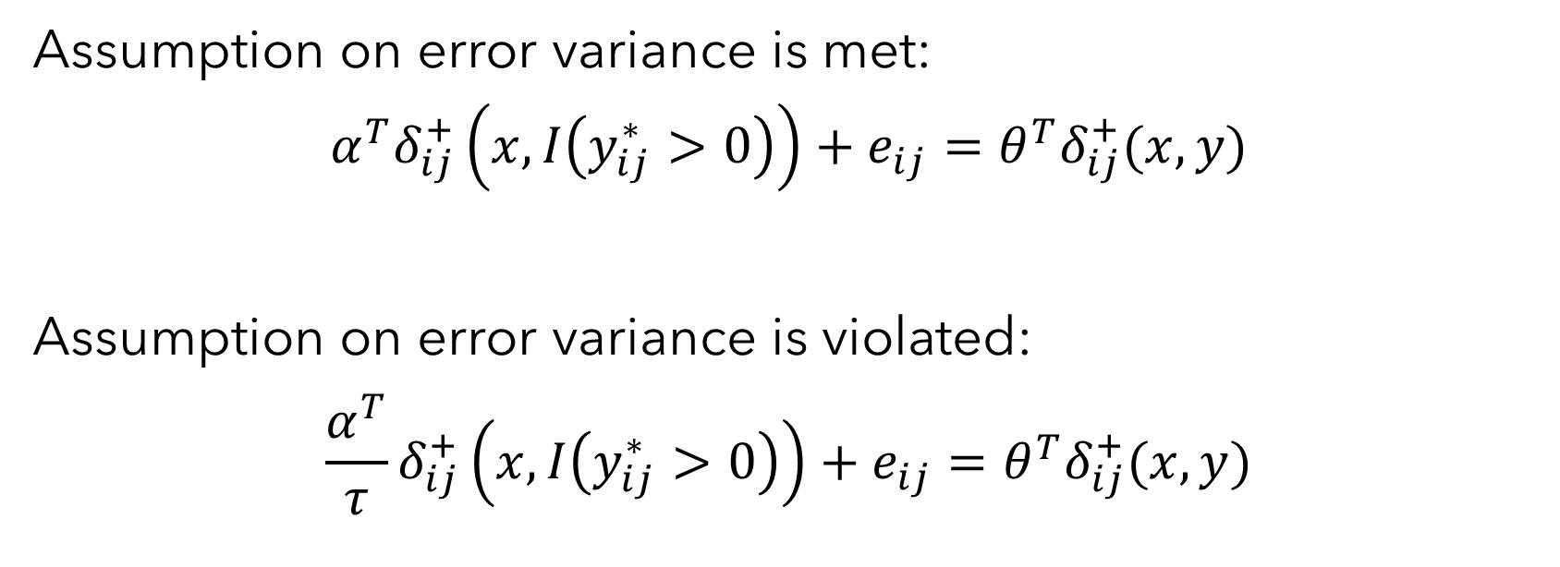

A latent linear modeling perspective on ERGM
However, when e is NOT a logistic random variable, this equality is violated.
It can be shown that $θ$ rescales, such that:
$$\frac{α}{τ}=θ$$
Assumption on error variance is met:
$$α^{T}δ_{ij}^{+}\left(x,I\left(y_{ij}^{∗}>0\right)\right)+e_{ij}=θ^{T}δ_{ij}^{+}(x,y)$$
Assumption on error variance is violated:
$$\frac{α^{T}}{τ}δ_{ij}^{+}\left(x,I\left(y_{ij}^{∗}>0\right)\right)+e_{ij}=θ^{T}δ_{ij}^{+}(x,y)$$
$τ$ is the ratio of the assumed ($\frac{π^{2}}{3}$) error variance to the true error variance

Slide 16

A latent linear modeling perspective on ERGM
More succinctly, we can express the equalities in terms of coefficients alone
This is known as the problem of “scaling” in the social sciences, “noncollapsability” in demography and medical sciences, and sometimes as “unobserved heterogeneity” or “latent heteroskedasticity” in econometrics and psychology
Assumption on error variance is met:
$$α =θ$$
Assumption on error variance is violated:
$$\frac{α}{τ}=θ$$
$τ$ is the ratio of the assumed ($\frac{π^{2}}{3}$) error variance to the true error variance

Slide 17
Causes of scaling in ERGM
An omitted variable even those that are not correlated with other predictors
An incorrect functional form
Measurement error
Scaling is usually present in applied research and is impossible to test—we must assume that we have it in our models

Slide 18
Three primary consequences of scaling
Biased effect size estimates
Comparisons of coefficients between groups are biased
Comparisons of coefficients between models are biased

Slide 19
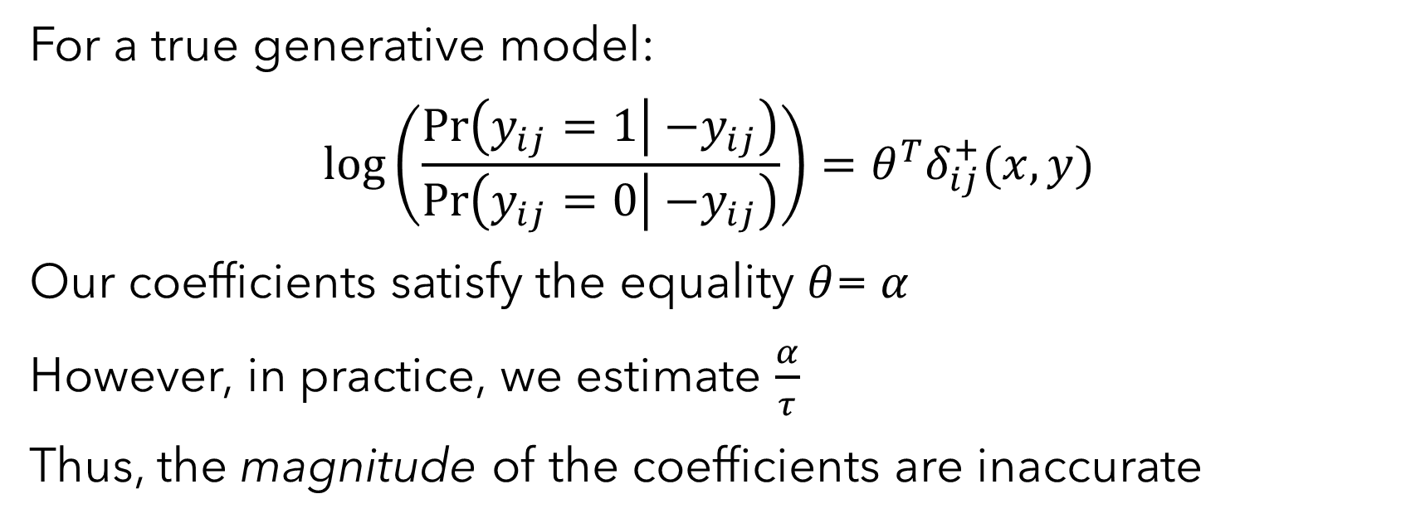
Biased effect size estimates
For a true generative model:
$$\log\left(\frac{\operatorname{Pr}\left(y_{ij}=1 | { −y}_{ij}\right)}{\operatorname{Pr}\left(y_{ij}=0 | { −y}_{ij}\right)}\right)=θ^{T}δ_{ij}^{+}(x,y)$$
Our coefficients satisfy the equality $θ$= $α$
However, in practice, we estimate $\frac{α}{τ}$
Thus, the magnitude of the coefficients are inaccurate

Slide 20
Biased effect size estimates
The magnitude of the coefficients are inaccurate in the presence of scaling
However, the significance and direction of the coefficients are accurate*
Further, the ranking of coefficients within a model are accurate*
*does not apply to interactions

Slide 21
Biased interactions
The second consequence is biased interactions—including homophily (same race, absolute difference in income) and heterophily coefficients
Interaction coefficients may be the incorrect sign, incorrect level of significance, and incorrect size
We may conclude no moderation when moderation is present, conclude moderation in the incorrect direction, or conclude moderation spuriously

Slide 22
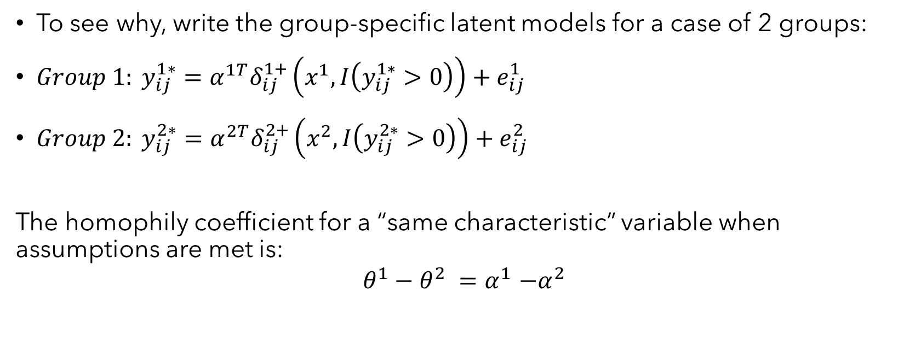
Biased interactions
To see why, write the group-specific latent models for a case of 2 groups:
$Group 1: y_{ij}^{1∗}=α^{1T}δ_{ij}^{1+}\left(x^{1},I\left(y_{ij}^{1∗}>0\right)\right)+e_{ij}^{1}$
${Group 2: y}_{ij}^{2∗}=α^{2T}δ_{ij}^{2+}\left(x^{2},I\left(y_{ij}^{2∗}>0\right)\right)+e_{ij}^{2}$
The homophily coefficient for a “same characteristic” variable when assumptions are met is:
$$θ^{1}−θ^{2} {=α}^{1}−α^{2}$$

Slide 23
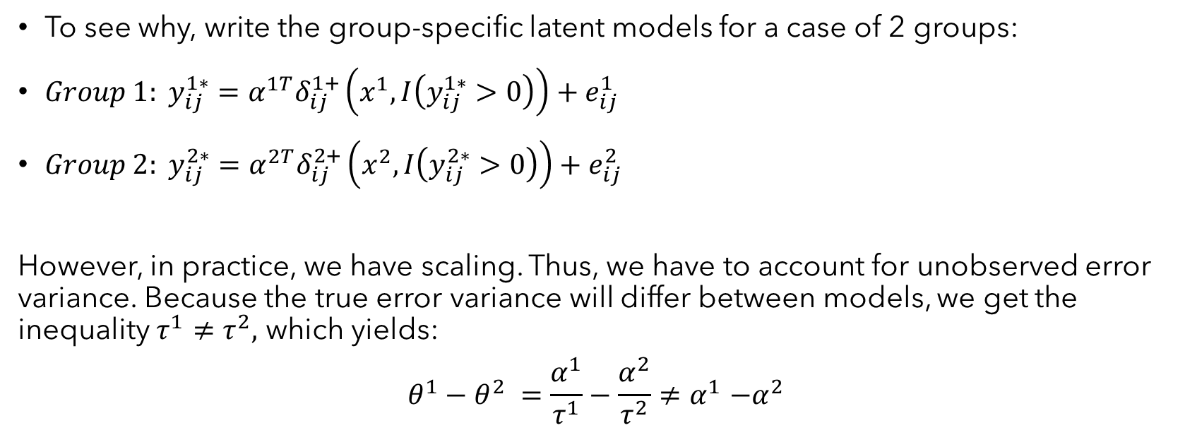
Biased interactions
To see why, write the group-specific latent models for a case of 2 groups:
$Group 1: y_{ij}^{1∗}=α^{1T}δ_{ij}^{1+}\left(x^{1},I\left(y_{ij}^{1∗}>0\right)\right)+e_{ij}^{1}$
${Group 2: y}_{ij}^{2∗}=α^{2T}δ_{ij}^{2+}\left(x^{2},I\left(y_{ij}^{2∗}>0\right)\right)+e_{ij}^{2}$
However, in practice, we have scaling. Thus, we have to account for unobserved error variance. Because the true error variance will differ between models, we get the inequality $τ^{1}≠τ^{2},$ which yields:
$$θ^{1}−θ^{2} {=\frac{α^{1}}{τ^{1}}−\frac{α^{2}}{τ^{2}}≠α}^{1}−α^{2}$$

Slide 24
Biased interactions
Thus, interactions are biased.
In other words, a positive homophily coefficient may not be evidence of homophily
To see why, write the group-specific latent models for a case of 2 groups:
$Group 1: y_{ij}^{1∗}=α^{1T}δ_{ij}^{1+}\left(x^{1},I\left(y_{ij}^{1∗}>0\right)\right)+e_{ij}^{1}$
${Group 2: y}_{ij}^{2∗}=α^{2T}δ_{ij}^{2+}\left(x^{2},I\left(y_{ij}^{2∗}>0\right)\right)+e_{ij}^{2}$
However, in practice, we have scaling. Thus, we have to account for unobserved error variance. Because the true error variance will differ between models, we get the inequality $τ^{1}≠τ^{2},$ which yields:
$$θ^{1}−θ^{2} {=\frac{α^{1}}{τ^{1}}−\frac{α^{2}}{τ^{2}}≠α}^{1}−α^{2}$$

Slide 25
Biased coefficient comparisons
The third consequence is that we cannot compared coefficients between nested models.
For example, if we want to see if including a GWESP parameter attenuates a homophily parameter or want to conduct mediation analysis
Differences in coefficients may be the incorrect sign, incorrect level of significance, or incorrect size
We may conclude no mediation when mediation is present, conclude mediation in the incorrect direction, or conclude mediation spuriously

Slide 26
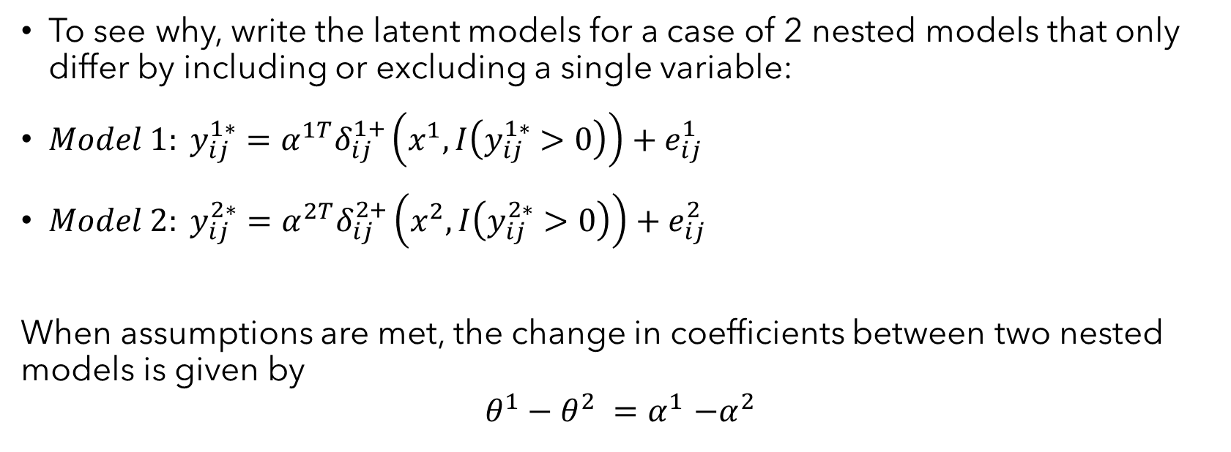
Biased coefficient comparisons
To see why, write the latent models for a case of 2 nested models that only differ by including or excluding a single variable:
$Model 1: y_{ij}^{1∗}=α^{1T}δ_{ij}^{1+}\left(x^{1},I\left(y_{ij}^{1∗}>0\right)\right)+e_{ij}^{1}$
${Model 2: y}_{ij}^{2∗}=α^{2T}δ_{ij}^{2+}\left(x^{2},I\left(y_{ij}^{2∗}>0\right)\right)+e_{ij}^{2}$
When assumptions are met, the change in coefficients between two nested models is given by
$$θ^{1}−θ^{2} {=α}^{1}−α^{2}$$

Slide 27
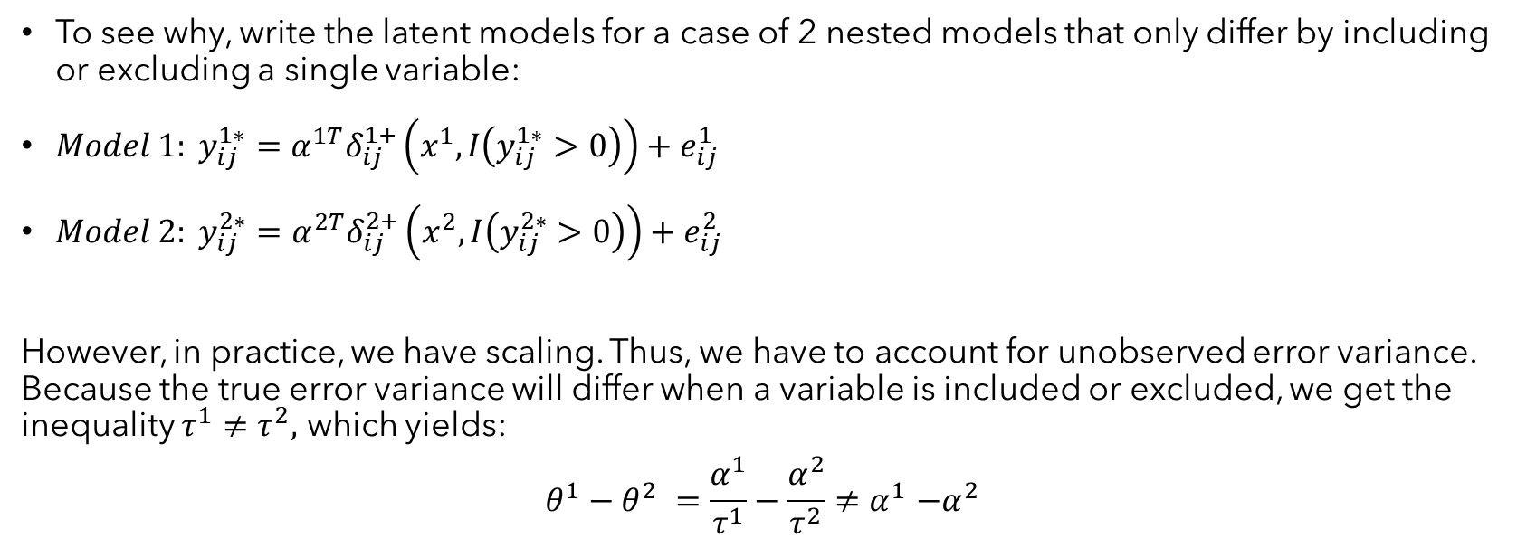
Biased coefficient comparisons
To see why, write the latent models for a case of 2 nested models that only differ by including or excluding a single variable:
$Model 1: y_{ij}^{1∗}=α^{1T}δ_{ij}^{1+}\left(x^{1},I\left(y_{ij}^{1∗}>0\right)\right)+e_{ij}^{1}$
${Model 2: y}_{ij}^{2∗}=α^{2T}δ_{ij}^{2+}\left(x^{2},I\left(y_{ij}^{2∗}>0\right)\right)+e_{ij}^{2}$
However, in practice, we have scaling. Thus, we have to account for unobserved error variance. Because the true error variance will differ when a variable is included or excluded, we get the inequality $τ^{1}≠τ^{2},$ which yields:
$$θ^{1}−θ^{2} {=\frac{α^{1}}{τ^{1}}−\frac{α^{2}}{τ^{2}}≠α}^{1}−α^{2}$$

Slide 28
Biased coefficient comparisons
Thus, we cannot compare coefficients between multiple ERGMs fit to the same data
To see why, write the latent models for a case of 2 nested models that only differ by including or excluding a single variable:
$Model 1: y_{ij}^{1∗}=α^{1T}δ_{ij}^{1+}\left(x^{1},I\left(y_{ij}^{1∗}>0\right)\right)+e_{ij}^{1}$
${Model 2: y}_{ij}^{2∗}=α^{2T}δ_{ij}^{2+}\left(x^{2},I\left(y_{ij}^{2∗}>0\right)\right)+e_{ij}^{2}$
However, in practice, we have scaling. Thus, we have to account for unobserved error variance. Because the true error variance will differ when a variable is included or excluded, we get the inequality $τ^{1}≠τ^{2},$ which yields:
$$θ^{1}−θ^{2} {=\frac{α^{1}}{τ^{1}}−\frac{α^{2}}{τ^{2}}≠α}^{1}−α^{2}$$

Slide 29
Several remarks
It is increasingly common for some scholars to argue that scaling is only relevant when we are interested in the latent coefficients and NOT the observed coefficients
This argument should be treated with extreme skepticism

Slide 30
Reasons to be concerned with scaling if the interest is in observed coefficients for a binary outcome
We often measure networks with latent constructs in mind.
a. Think about common social network measures: friendship indicators, perceptions of status and power, or measures of affiliation. These are often measured as binary but reflect continuous latent measures. If the coefficients for a binary measure can provide us with a completely different conclusion than the coefficients for a latent variable, then we have a big problem in our inference.

Slide 31
Reasons to be concerned with scaling if the interest is in observed coefficients for a binary outcome
We often measure networks with latent constructs in mind.
It can be shown that the ERGM coefficients rescale even without reference to a latent linear model.
In other words, the bias persists whether we are interested in observed coefficients or latent coefficients.
See Allison (1999) or Gail (1984) for derivations in the case of logistic regression.

Slide 32
Reasons to be concerned with scaling if the interest is in observed coefficients for a binary outcome
We often measure networks with latent constructs in mind.
It can be shown that the ERGM coefficients rescale even without reference to a latent linear model.
A quick illustration in R

Slide 33
Workshop overview
Discuss why special procedures are necessary to conduct mediation and moderation analysis in ERGM
Overview procedures for testing indirect effects and interaction effects
a. Single mediator models, multiple mediator models, moderated mediation, and mediated moderation
Introduce ergMargins

Slide 34
How to handle scaling
Effect size estimates
Interaction effects in moderation analysis
Indirect effects in mediation analysis
Extended cases: Moderated mediation and mediated moderation

Slide 35
Effect size interpretations
An interesting property of scaling is that the predictions from ERGM are not affected by scaling even though scaling biases coefficients.

Slide 36
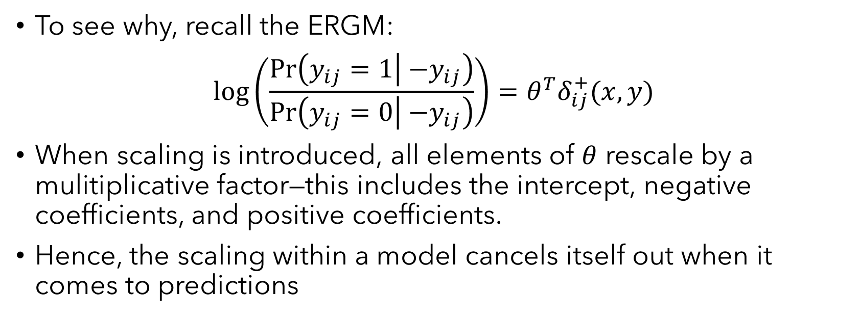
Effect size interpretations
To see why, recall the ERGM:
$$\log\left(\frac{\operatorname{Pr}\left(y_{ij}=1 | { −y}_{ij}\right)}{\operatorname{Pr}\left(y_{ij}=0 | { −y}_{ij}\right)}\right)=θ^{T}δ_{ij}^{+}(x,y)$$
When scaling is introduced, all elements of $θ$ rescale by a mulitiplicative factor—this includes the intercept, negative coefficients, and positive coefficients.
Hence, the scaling within a model cancels itself out when it comes to predictions

Slide 37
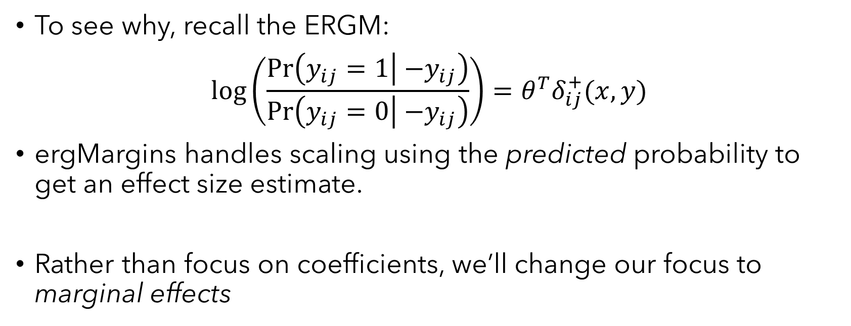
Effect size interpretations
To see why, recall the ERGM:
$$\log\left(\frac{\operatorname{Pr}\left(y_{ij}=1 | { −y}_{ij}\right)}{\operatorname{Pr}\left(y_{ij}=0 | { −y}_{ij}\right)}\right)=θ^{T}δ_{ij}^{+}(x,y)$$
ergMargins handles scaling using the predicted probability to get an effect size estimate.
Rather than focus on coefficients, we’ll change our focus to marginal effects

Slide 38
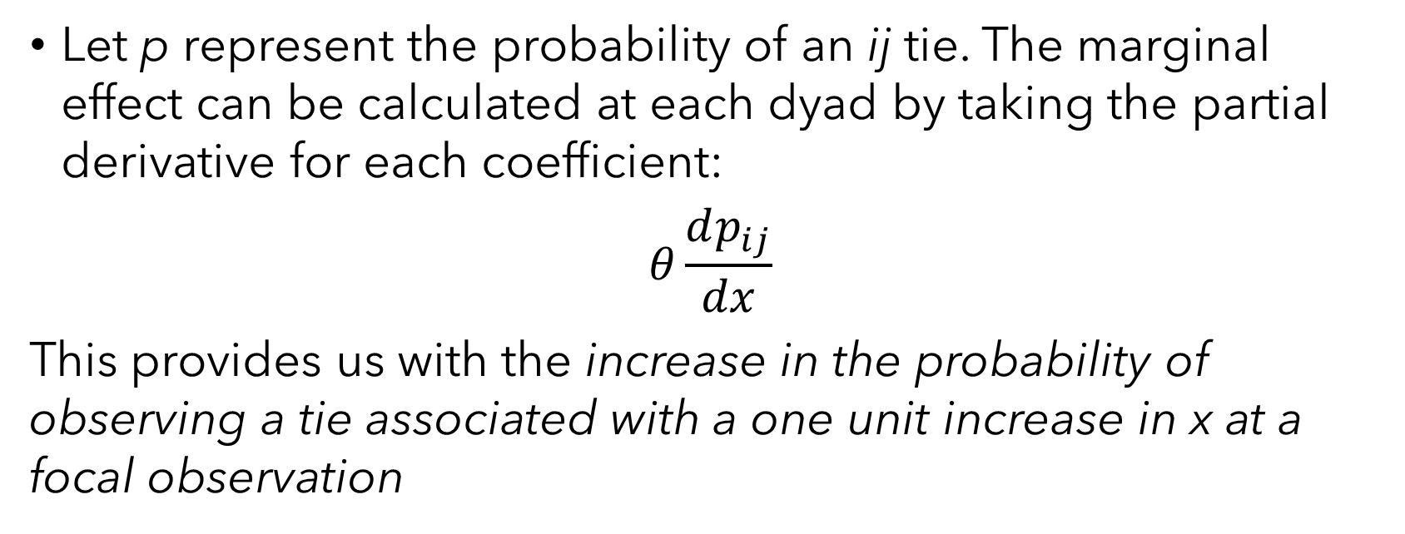
Effect size interpretations
Let p represent the probability of an ij tie. The marginal effect can be calculated at each dyad by taking the partial derivative for each coefficient:
$$θ\frac{dp_{ij}}{dx}$$
This provides us with the increase in the probability of observing a tie associated with a one unit increase in x at a focal observation

Slide 39
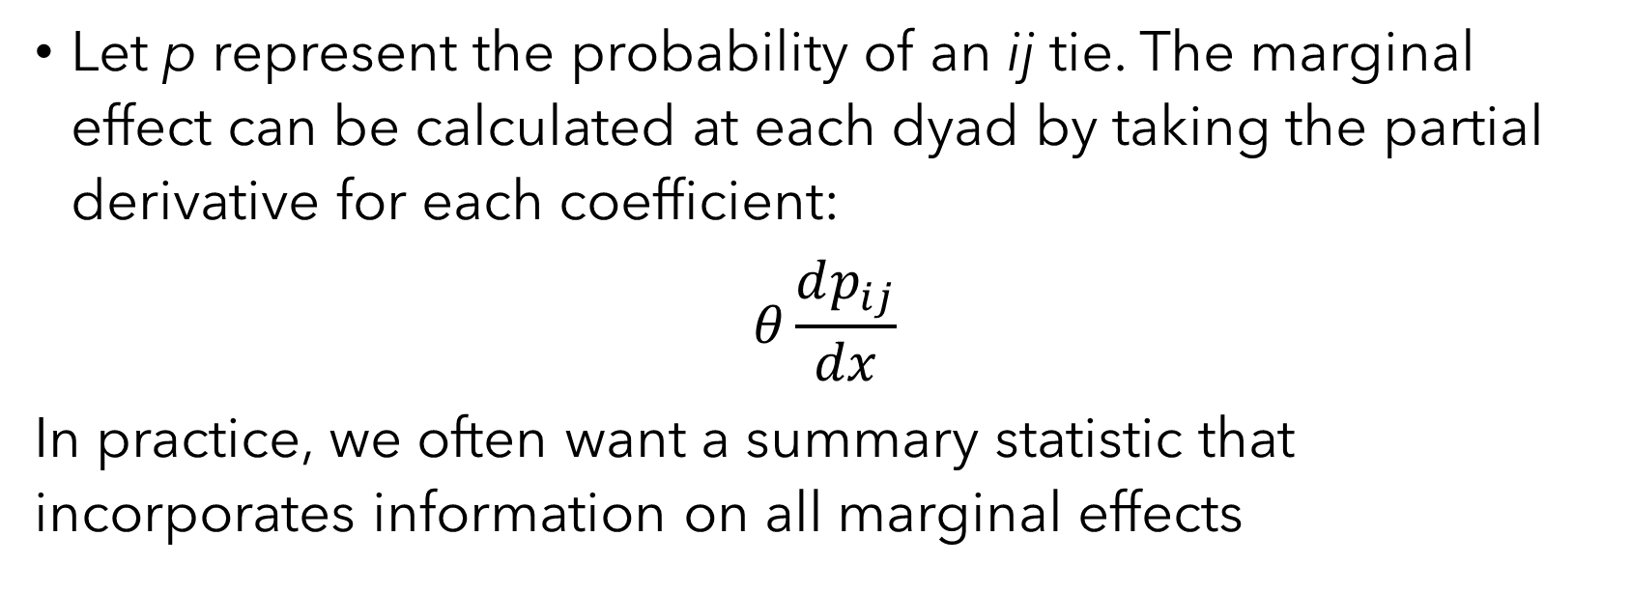
Effect size interpretations
Let p represent the probability of an ij tie. The marginal effect can be calculated at each dyad by taking the partial derivative for each coefficient:
$$θ\frac{dp_{ij}}{dx}$$
In practice, we often want a summary statistic that incorporates information on all marginal effects

Slide 40
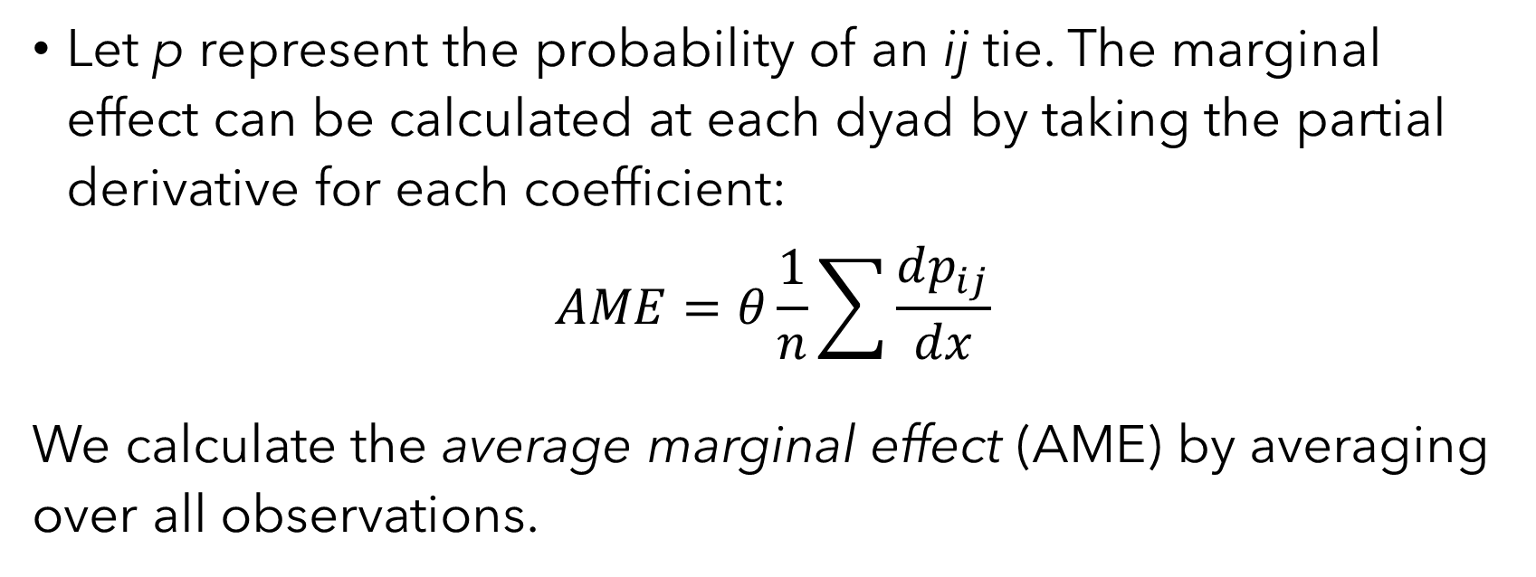
Effect size interpretations
Let p represent the probability of an ij tie. The marginal effect can be calculated at each dyad by taking the partial derivative for each coefficient:
$$AME=θ\frac{1}{n}\sum{\frac{dp_{ij}}{dx}}$$
We calculate the average marginal effect (AME) by averaging over all observations.

Slide 41
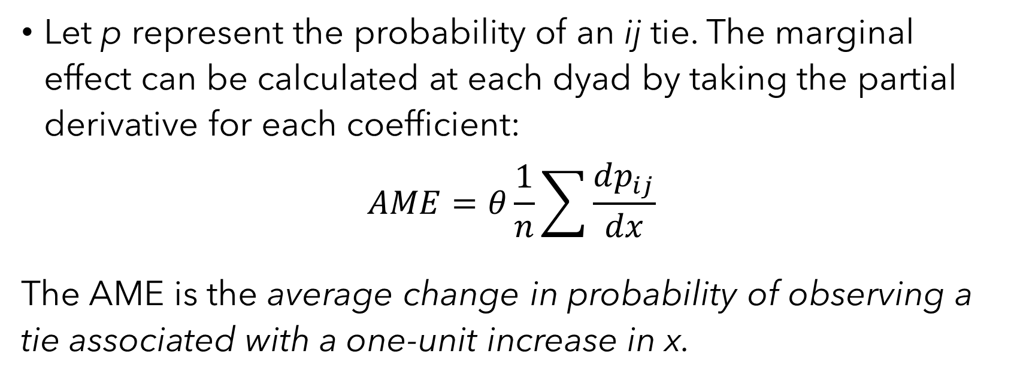
Effect size interpretations
Let p represent the probability of an ij tie. The marginal effect can be calculated at each dyad by taking the partial derivative for each coefficient:
$$AME=θ\frac{1}{n}\sum{\frac{dp_{ij}}{dx}}$$
The AME is the average change in probability of observing a tie associated with a one-unit increase in x.

Slide 42
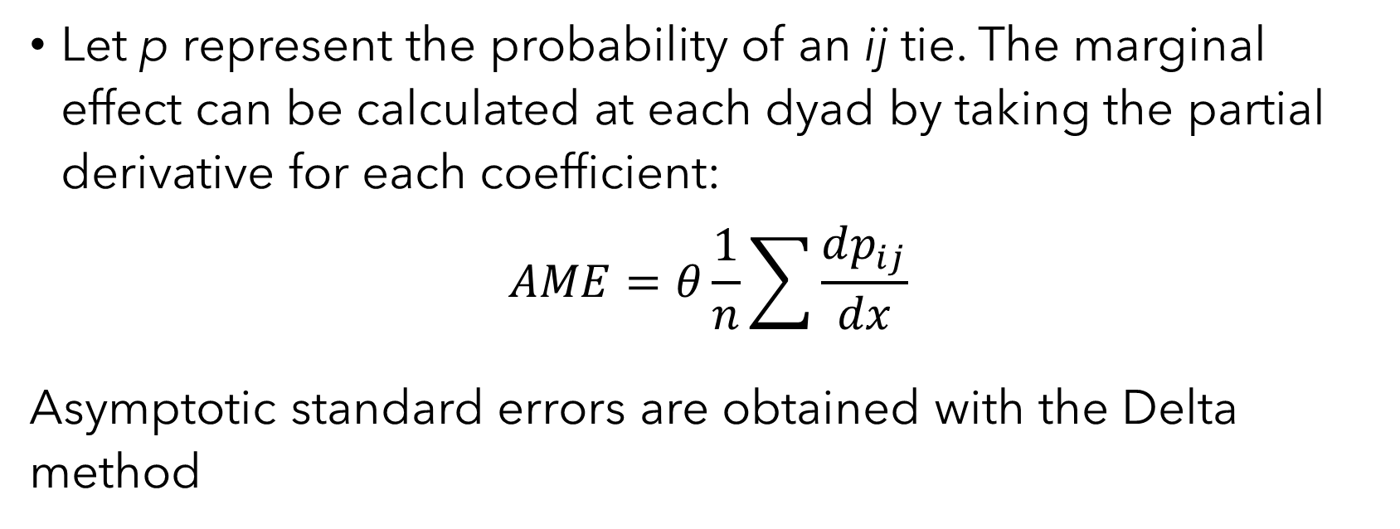
Effect size interpretations
Let p represent the probability of an ij tie. The marginal effect can be calculated at each dyad by taking the partial derivative for each coefficient:
$$AME=θ\frac{1}{n}\sum{\frac{dp_{ij}}{dx}}$$
Asymptotic standard errors are obtained with the Delta method

Slide 43
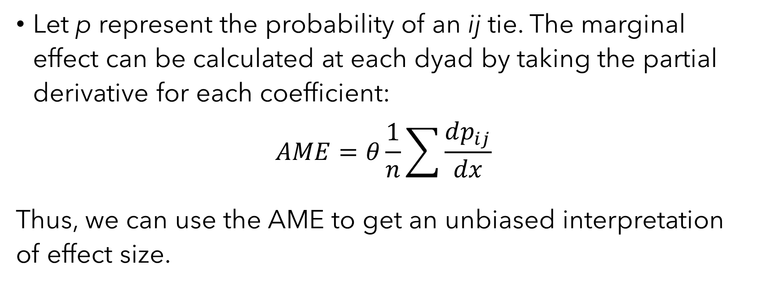
Effect size interpretations
Let p represent the probability of an ij tie. The marginal effect can be calculated at each dyad by taking the partial derivative for each coefficient:
$$AME=θ\frac{1}{n}\sum{\frac{dp_{ij}}{dx}}$$
Thus, we can use the AME to get an unbiased interpretation of effect size.

Slide 44
Moderation analysis
The essence of moderation analysis is to estimate the change in AME when a moderating variable is increased by 1.
Then we test the change in AME under the null hypothesis that no moderation = no change.

Slide 45
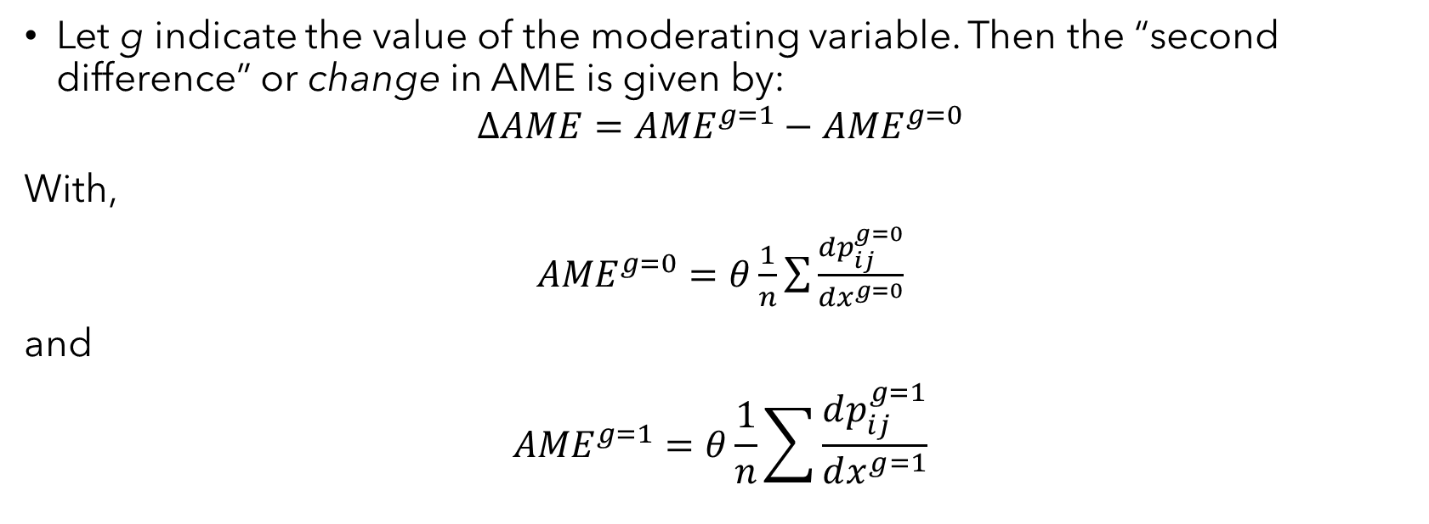
Moderation analysis
In words, we calculate the AME when a moderator is equal to 0, then calculate a second AME when the moderator is equal to 1. If there is no moderation, the change in AME should be insignificant
Let g indicate the value of the moderating variable. Then the “second difference” or change in AME is given by:
$${{∆AME=AME}^{g=1}−AME}^{g=0}$$
With,
${AME}^{g=0}=θ\frac{1}{n}\sum{\frac{dp_{ij}^{g=0}}{dx^{g=0}}}$
and
$${AME}^{g=1}=θ\frac{1}{n}\sum{\frac{dp_{ij}^{g=1}}{dx^{g=1}}}$$
Hypothesis tests are completed using Delta method approximations

Slide 46
Mediation analysis
The essence of mediation analysis is similar to moderation analysis.
We fit two models: one without the confounding variable, one with the confounding variable
Then we test the change in AME under the null hypothesis that no moderation = no change.

Slide 47
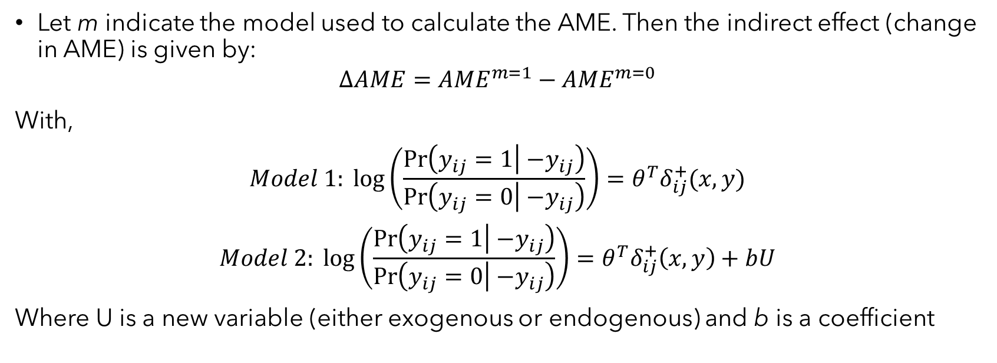
Moderation analysis
Let m indicate the model used to calculate the AME. Then the indirect effect (change in AME) is given by:
$${{∆AME=AME}^{m=1}−AME}^{m=0}$$
With,
$$Model 1: \log\left(\frac{\operatorname{Pr}\left(y_{ij}=1 | { −y}_{ij}\right)}{\operatorname{Pr}\left(y_{ij}=0 | { −y}_{ij}\right)}\right)=θ^{T}δ_{ij}^{+}(x,y)$$
$$Model 2: \log\left(\frac{\operatorname{Pr}\left(y_{ij}=1 | { −y}_{ij}\right)}{\operatorname{Pr}\left(y_{ij}=0 | { −y}_{ij}\right)}\right)=θ^{T}δ_{ij}^{+}\left(x,y\right)+bU$$
Where U is a new variable (either exogenous or endogenous) and b is a coefficient

Slide 48
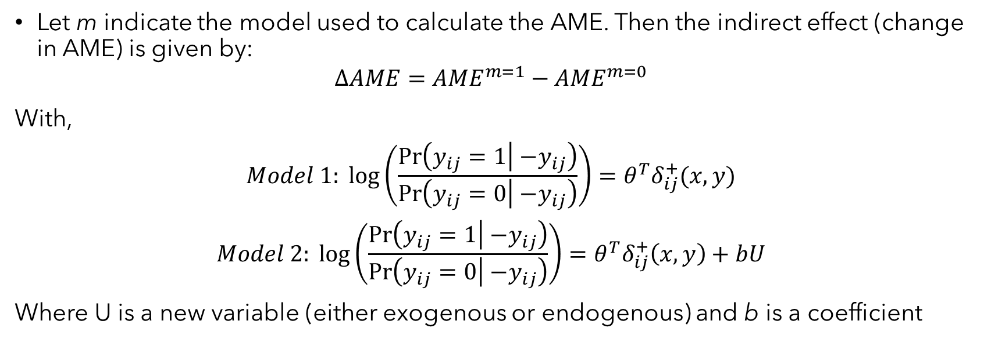
Moderation analysis
The indirect effect can be interpreted as the change in probability of an ij tie when x increases by one unit that can be attributed to a confounding variable, U
Let m indicate the model used to calculate the AME. Then the indirect effect (change in AME) is given by:
$${{∆AME=AME}^{m=1}−AME}^{m=0}$$
With,
$$Model 1: \log\left(\frac{\operatorname{Pr}\left(y_{ij}=1 | { −y}_{ij}\right)}{\operatorname{Pr}\left(y_{ij}=0 | { −y}_{ij}\right)}\right)=θ^{T}δ_{ij}^{+}(x,y)$$
$$Model 2: \log\left(\frac{\operatorname{Pr}\left(y_{ij}=1 | { −y}_{ij}\right)}{\operatorname{Pr}\left(y_{ij}=0 | { −y}_{ij}\right)}\right)=θ^{T}δ_{ij}^{+}\left(x,y\right)+bU$$
Where U is a new variable (either exogenous or endogenous) and b is a coefficient

Slide 49
Moderation analysis
Standard errors are estimated using the Delta method and seemingly unrelated regression
Let m indicate the model used to calculate the AME. Then the indirect effect (change in AME) is given by:
$${{∆AME=AME}^{m=1}−AME}^{m=0}$$
With,
$$Model 1: \log\left(\frac{\operatorname{Pr}\left(y_{ij}=1 | { −y}_{ij}\right)}{\operatorname{Pr}\left(y_{ij}=0 | { −y}_{ij}\right)}\right)=θ^{T}δ_{ij}^{+}(x,y)$$
$$Model 2: \log\left(\frac{\operatorname{Pr}\left(y_{ij}=1 | { −y}_{ij}\right)}{\operatorname{Pr}\left(y_{ij}=0 | { −y}_{ij}\right)}\right)=θ^{T}δ_{ij}^{+}\left(x,y\right)+bU$$
Where U is a new variable (either exogenous or endogenous) and b is a coefficient

Slide 50
Now let’s implement the methods in R using ergMargins

